Slide 2
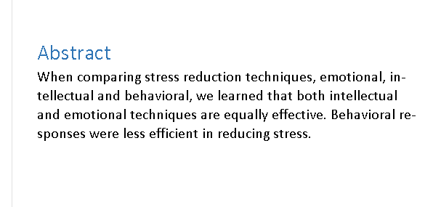

Slide 3
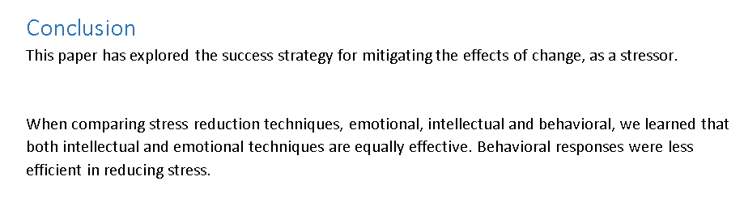

Slide 4
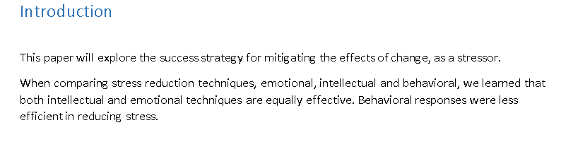

Slide 5
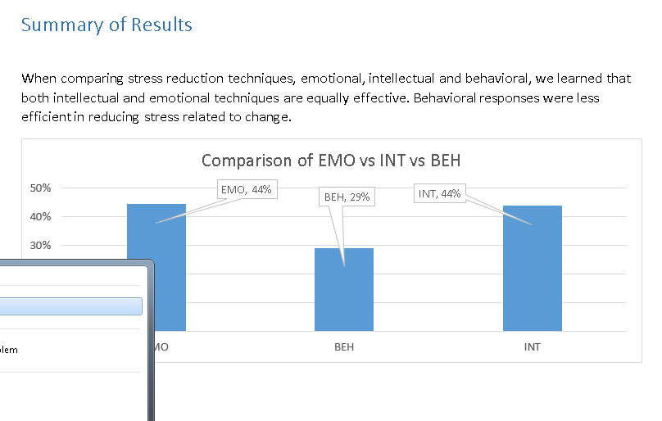

Slide 6
Difference?
None, restate your major points multiple times
LS, DOE, RESULTS ARE THE ENGINE OF THE PAPER
ALL ELSE IS REITERATIVE

